Slide 1
ByteArrayInputStream
ByteArrayInputStream is an implementation of an input stream that uses a byte array as the source.
Closing a ByteArrayInputStream has no effect. The methods in this class can be called after the stream has been closed without generating an IOException.
ByteArrayInputStream
Java Application
Read
Read
ByteArray

Slide 2
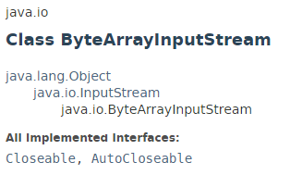
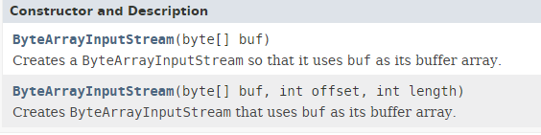
ByteArrayInputStream

Slide 3
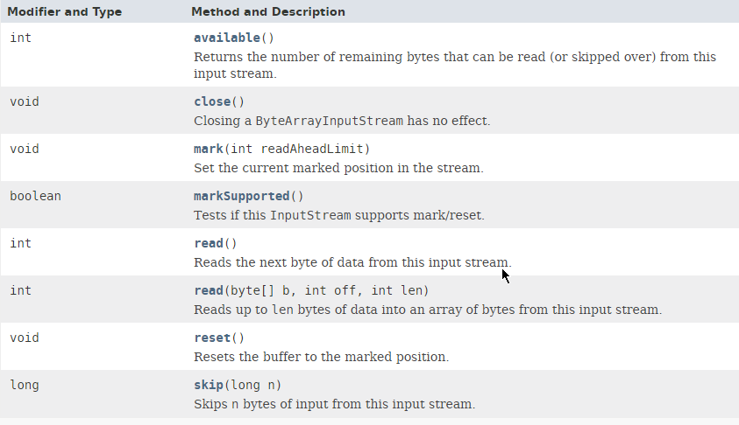
ByteArrayInputStream

Slide 4
ByteArrayInputStream
https://docs.oracle.com/javase/8/docs/api/index.html?java/io/ByteArrayInputStream.html

